Slide 1
Bayesian networks
It is a mathematical model for reasoning where prior beliefs are combined with evidence to get estimates of uncertainty
Developed by Thomas Bayes in 1763

Slide 2
Key Terms
Hypothesis nodes
Evidence nodes
Conditional Probability Table(CPT)
Conditional Probability
Conditional nodes(Parents nodes present)
Unconditional nodes(without Parents)

Slide 3
Bayesian networks
A simple, graphical notation for conditional independence assertions and hence for compact specification of full joint distributions
Syntax:
  a set of nodes, one per variable
  a directed, acyclic graph (link ≈ "directly influences")
  a conditional distribution for each node given its parents:
    P (X_{i} | Parents (X_{i}))
In the simplest case, conditional distribution represented as a conditional probability table (CPT) giving the distribution over X_{i} for each combination of parent values

Slide 4

Example
Topology of network encodes conditional independence assertions:
Weather is independent of the other variables
Toothache and Catch are conditionally independent given Cavity

Slide 5
Example
I'm at work, neighbor John calls to say my alarm is ringing, but neighbor Mary doesn't call. Sometimes it's set off by minor earthquakes. Is there a burglar?
Variables: Burglary, Earthquake, Alarm, JohnCalls, MaryCalls
Network topology reflects "causal" knowledge:
  A burglar can set the alarm off
  An earthquake can set the alarm off
  The alarm can cause Mary to call
  The alarm can cause John to call

Slide 6
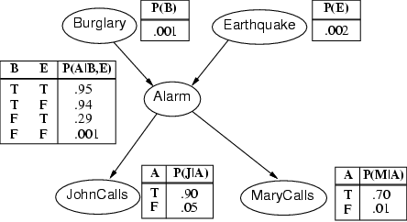
Example contd.

Slide 7
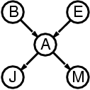
Compactness
A CPT for Boolean X_{i} with k Boolean parents has 2^{k} rows for the combinations of parent values
Each row requires one number p for X_{i} = true
(the number for X_{i} = false is just 1-p)
If each variable has no more than k parents, the complete network requires O(n · 2^{k}) numbers
I.e., grows linearly with n, vs. O(2^{n}) for the full joint distribution
For burglary net, 1 + 1 + 4 + 2 + 2 = 10 numbers (vs. 2⁵-1 = 31)

Slide 8
Semantics
The full joint distribution is defined as the product of the local conditional distributions:
P (X₁, … ,X_{n}) = π_{i = 1} P (X_{i} | Parents(X_{i}))
e.g., P(j ∧ m ∧ a ∧ ¬b ∧ ¬e)
= P (j | a) P (m | a) P (a | ¬b, ¬e) P (¬b) P (¬e)
n

Slide 9
Constructing Bayesian networks
1. Choose an ordering of variables X₁, … ,X_{n}
2. For i = 1 to n
  add X_{i} to the network
  select parents from X₁, … ,X_{i-1} such that
  P (X_{i} | Parents(X_{i})) = P (X_{i} | X₁, ... X_{i-1})
This choice of parents guarantees:
P (X₁, … ,X_{n}) = π_{i =1} P (X_{i} | X₁, … , X_{i-1})
= π_{i =1}P (X_{i} | Parents(X_{i}))
(by construction)
(chain rule)
n
n

Slide 10
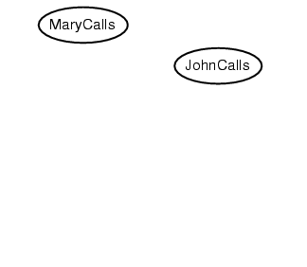
Example
Suppose we choose the ordering M, J, A, B, E
P(J | M) = P(J)?

Slide 11
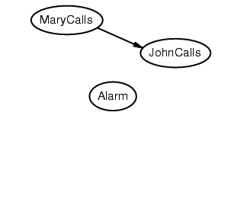
Example
Suppose we choose the ordering M, J, A, B, E
P(J | M) = P(J)?
P(A | J, M) = P(A | J)? P(A | J, M) = P(A)?
No

Slide 12
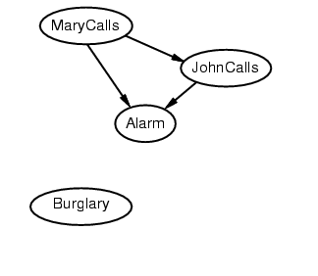
Example
Suppose we choose the ordering M, J, A, B, E
P(J | M) = P(J)?
P(A | J, M) = P(A | J)? P(A | J, M) = P(A)? No
P(B | A, J, M) = P(B | A)?
P(B | A, J, M) = P(B)?
No

Slide 13
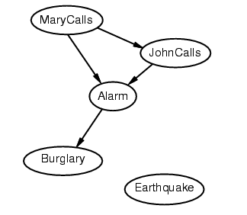
Example
Suppose we choose the ordering M, J, A, B, E
P(J | M) = P(J)?
P(A | J, M) = P(A | J)? P(A | J, M) = P(A)? No
P(B | A, J, M) = P(B | A)? Yes
P(B | A, J, M) = P(B)? No
P(E | B, A ,J, M) = P(E | A)?
P(E | B, A, J, M) = P(E | A, B)?
No

Slide 14
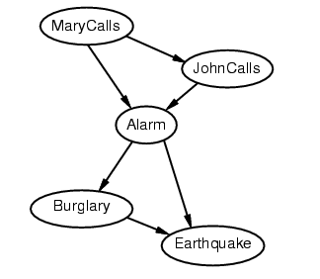
Example
Suppose we choose the ordering M, J, A, B, E
P(J | M) = P(J)?
P(A | J, M) = P(A | J)? P(A | J, M) = P(A)? No
P(B | A, J, M) = P(B | A)? Yes
P(B | A, J, M) = P(B)? No
P(E | B, A ,J, M) = P(E | A)? No
P(E | B, A, J, M) = P(E | A, B)? Yes
No

Slide 15
Example contd.
Deciding conditional independence is hard in noncausal directions
(Causal models and conditional independence seem hardwired for humans!)
Network is less compact: 1 + 2 + 4 + 2 + 4 = 13 numbers needed

Slide 16
Inference
Complexity of inference Bayes Net
  Bayes Net reduces space complexity
  Bayes Net does not reduce time complexity for general case

Slide 17
Inference
Inference by enumeration
P(B | j, m) = P(B, j, m) / P(j, m)
= α P(B, j, m)
= α Σ_{a} Σ_{e} P(B, e, a, j, m)
= α P(B) Σ_{e} P(e) Σ_{a} P(a | B,e) P(j | a) P(m | a)

Slide 18
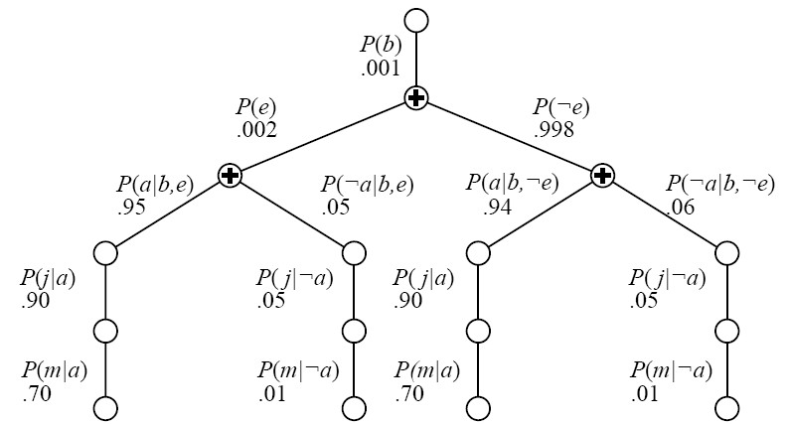
Time complexity
Enumeration is inefficient (e.g., computes P(j|a)P(m|a) for each value of e)
Dynamic programming

Slide 19
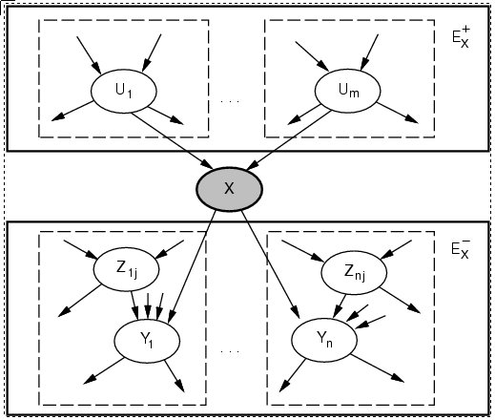
Inference for polytrees

Slide 20
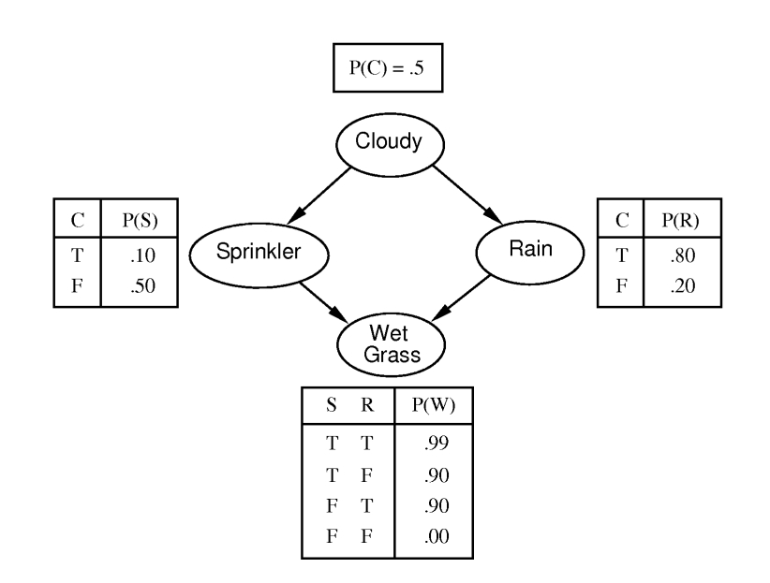
Inference in multiply connected networks
Clustering
Cutset conditioning
Stochastic methods
  Monte Carlo
  likelihood weighting
  Markov Chain Monte Carlo

Slide 21
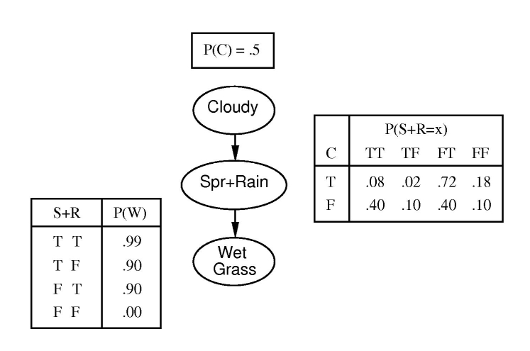
Clustering
Merge variables, replace their CPTs by their combined CPT

Slide 22
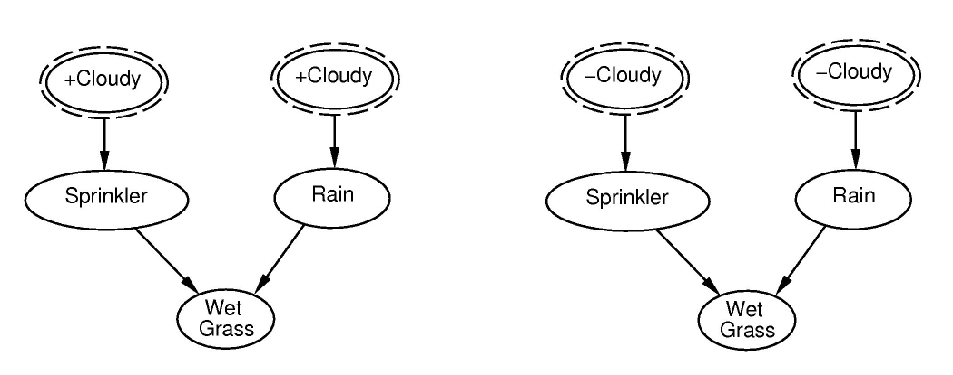
Cutset conditioning
cutting off cycles to obtain polytree.
Sum over all instantiations of cutset variables.

Slide 23
Stochastic Inference
It’s expensive to work with the full joint distribution… whether as a table or as a Bayes Network
Is approximation good enough?
Monte Carlo

Slide 24
Monte Carlo
Use samples to approximate solution
  Simulated annealing used Monte Carlo theories to justify why random guesses and sometimes going uphill can lead to optimality
More samples = better approximation
  How many are needed?
  Where should you take the samples?

Slide 25
Example
  P(Rain | Sprinkler = true)
  Use Bayes Net to generate 100 samples
    Suppose 73 have Sprinkler=false
    Suppose 27 have Sprinkler=true
      8 have Rain=true
      19 have Rain=false
  P(Rain | Sprinkler=true) = <8/27; 19/27>

Slide 26
Likelihood weighting
We only want to generate samples that are consistent with the evidence, e
  We’ll sample the Bayes Net, but we won’t let every random variable be sampled, some will be forced to produce a specific output

Slide 27
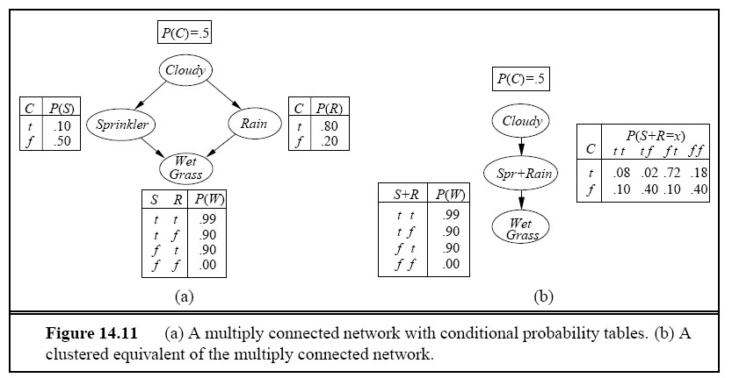
Example
P (Rain | Sprinkler=true, WetGrass=true)

Slide 28
Summary
Definition
Bayesian network structure
CPT, Conditional Dependency Graph
Example Diagram
Clustering

